Slide 1
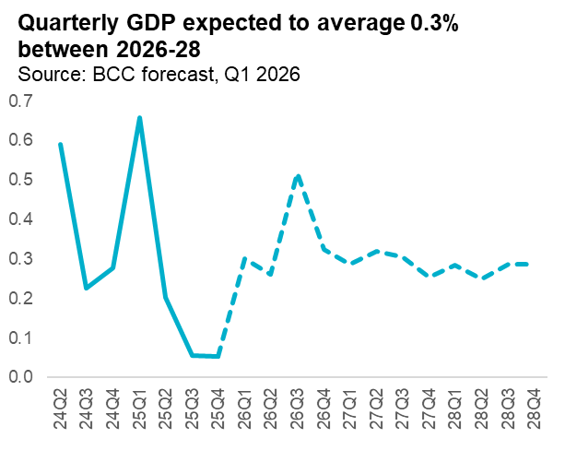


BRITISH CHAMBERS OF COMMERCE
QUARTERLY ECONOMIC FORECAST Q1 2026
10 March 2026
The latest British Chambers of Commerce (BCC) economic forecast suggests continued slow growth in 2026, higher inflation due to the current Middle East crisis, and rising unemployment.
GDP in 2026 revised down to 1.0% (from 1.2% in the previous forecast), with growth forecast of 1.3% in 2027, and 1.1% in 2028.
Global uncertainty is expected to push UK inflation higher than expected, reaching 2.7%
Unemployment is expected to increase to 5.5% in 2026 (up from 5.1% in the previous forecast), and stay at that rate through 2027, due to persistent high labour costs.
UK GDP is expected to grow by only 1.0% in 2026, reflecting a landscape of weak productivity, business investment, consumer spending, and ongoing global uncertainty. It is then forecast to pick up to 1.3% in 2027 and then 1.1% in 2028.
Business investment is expected to flatline this year (0%), a revision downwards from the previous forecast (0.9%). The rapid adoption of AI that the BCC has seen from its own evidence could support productivity gains, but this is likely to begin beyond 2028.
Export growth is forecast to slow to 0.7% this year (a downgrade from 1.8% in the last forecast). The downgrade reflects the impact of deepening global uncertainty, notably from the crisis in the Middle East and US tariff uncertainty.
1.0%
forecast GDP growth for 2026
0.0%
forecast business investment growth for 2026
2.7%
forecast CPI inflation rate by Q4 2026
GDP growth
Higher oil and gas prices linked to the current conflict in the Middle East are expected to push CPI inflation up to 2.7% by the end of 2026 (compared to 2.1% in the previous forecast). Inflation is then forecast to ease back towards the Bank of England’s target in 2027, slowing to 1.9% by Q4 2027, as energy prices fall and wage growth moderates. The interest rate is expected to remain at 3.75% this year, before cuts to 3.25% by the end of 2027.
Inflation
The unemployment rate is expected to rise to 5.5% in 2026 (up from the previous projection of 5.1%) with high labour costs dampening the hiring appetite of business. Unemployment is expected to remain elevated at 5.5% next year, before easing to 5.3% in 2028. Youth unemployment remains an area of concern as labour costs and AI erode entry level jobs. It expected to be 17% in 2026, peaking at 17.1% in 2027 before falling to 16.7% in 2028.
Employment

Slide 2
BRITISH CHAMBERS OF COMMERCE
QUARTERLY ECONOMIC FORECAST Q1 2026
10 March 2026
Current forecast (2026 Q1)
BCC Economic Full Forecast (Annual % change)
 | 2025 | 2026 | 2027 | 2028
GDP | 1.3 | 1.0 | 1.3 | 1.1
Household Consumption | 1.1 | 0.8 | 1.2 | 1.2
General government | 1.7 | 1.6 | 1.1 | 0.9
Investment | 3.5 | 1.2 | 2.5 | 1.1
of which: Business Investment | 3.8 | 0.0 | 1.3 | 0.9
Exports | 1.6 | 0.7 | 2.1 | 2.2
Imports | 4.2 | 0.6 | 2.4 | 2.2
Total Production | 0.3 | 0.6 | 1.2 | 1.0
Manufacturing | -0.2 | -0.3 | 0.8 | 0.8
Construction | 1.8 | -1.3 | 0.7 | 0.7
Services | 1.4 | 1.2 | 1.3 | 1.2
Unemployment rate %* | 4.8 | 5.5 | 5.5 | 5.3
Unemployment 000's** | 229.8 | 245.9 | 0.3 | -60.6
Youth unemployment rate %* | 14.9 | 17.0 | 17.1 | 16.7
Youth unemployment 000's** | 69.1 | 105.3 | 0.1 | -23.8
CPI inflation (Q4)^ | 3.4 | 2.7 | 1.9 | 1.8
Average earnings (Q4)^ | 5.2 | 3.9 | 2.9 | 3.1
Interest rates (end-of-year)* | 3.75 | 3.75 | 3.25 | 3.25
NetTrade-Goods&Services-%GDP* | -2.5 | -2.4 | -2.5 | -2.6
BofP-CurrentAccount-%GDP* | -2.4 | -3.3 | -3.6 | -3.7
PSNBex-BCC forecast-FinYears-%GDP* | 5.1 | 3.2 | 2.4 | 1.5
PSNBex-BCC forecast-FinYears-£bn* | 159.0 | 102.3 | 80.8 | 51.9
* Reported as levels
** Change in levels
^ Annual % change in Q4
The BCC forecast is produced using the National Institute Global Econometric Model (NiGEM) For more information, contact David Bharier, Head of Research
Email: d.bharier@britishchambers.org.uk

